Slide 1
Resilience in Commercial Real Estate: Post-COVID Comebacks & Strategic Opportunities
Datafest 2025
Eric Ge, Ezi Ilabor, Yae Young Kim, Kaley Wong

Slide 2
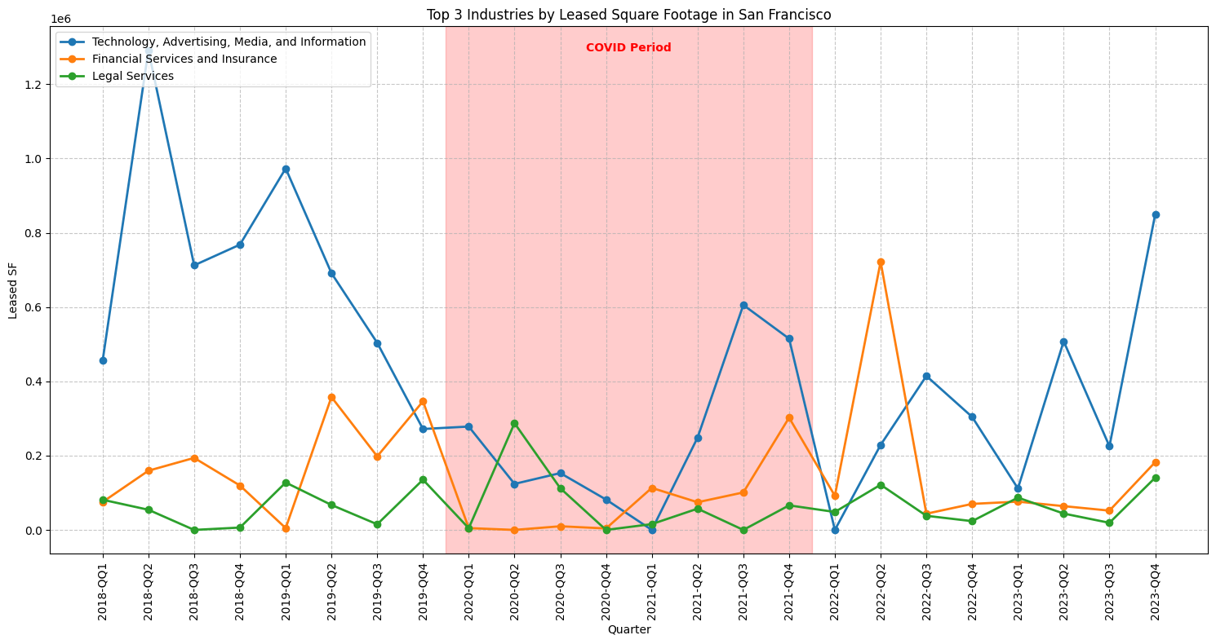
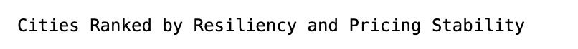
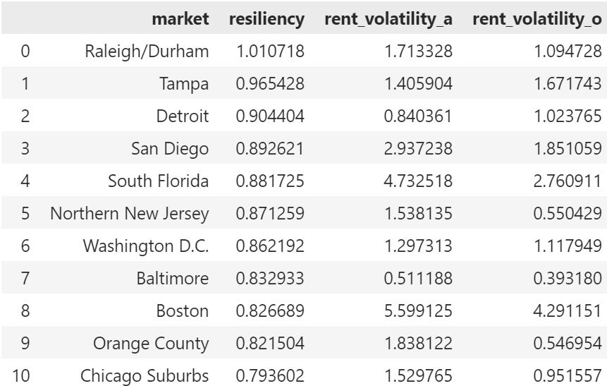
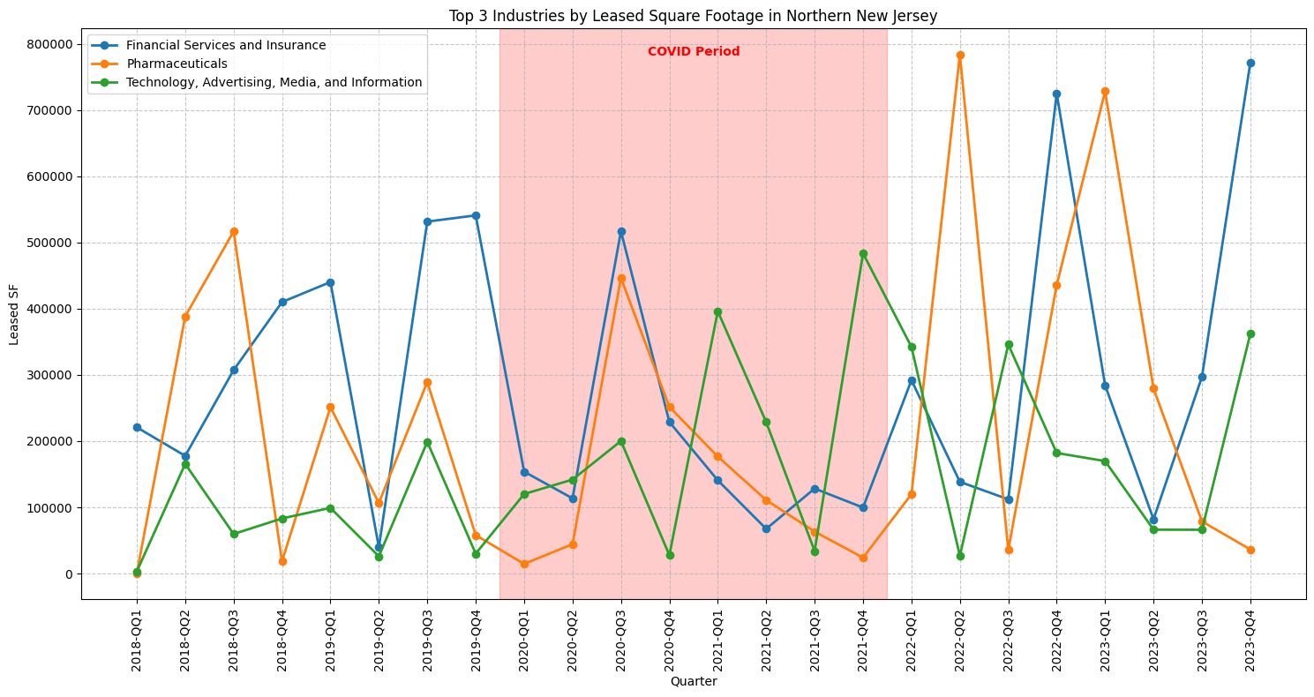
What Defines a Resilient Market?
Top 3 Industries by Leased Square Footage in San Francisco
Resiliency = How well a city maintained leasing activity during COVID → Higher = better Volatility = How much average rent prices fluctuated during COVID → Lower = better
resiliency_score = total_leased_sqft_during_covid / total_leased_sqft_pre_covid
Lease Price Volatility = Standard deviation of rent ÷ Average rent
Top 3 Industries by Leased Square Footage in Northern New Jersey
Key Insight for Savills: Focus on cities with high resilience and low volatility during future economic downturns. These cities stayed stable during COVID and are less risky for long-term investment. Examples: → Emerging tech hubs like Dallas and Houston
🟢 High Resilience + Low Volatility = Safe & Strong Market
🟡 High Resilience + High Volatility = Growth, but pricing chaos
🟠 Low Resilience + Low Volatility = Weak activity, stable prices
🔴 Low Resilience + High Volatility = Risky / Unstable

Slide 3
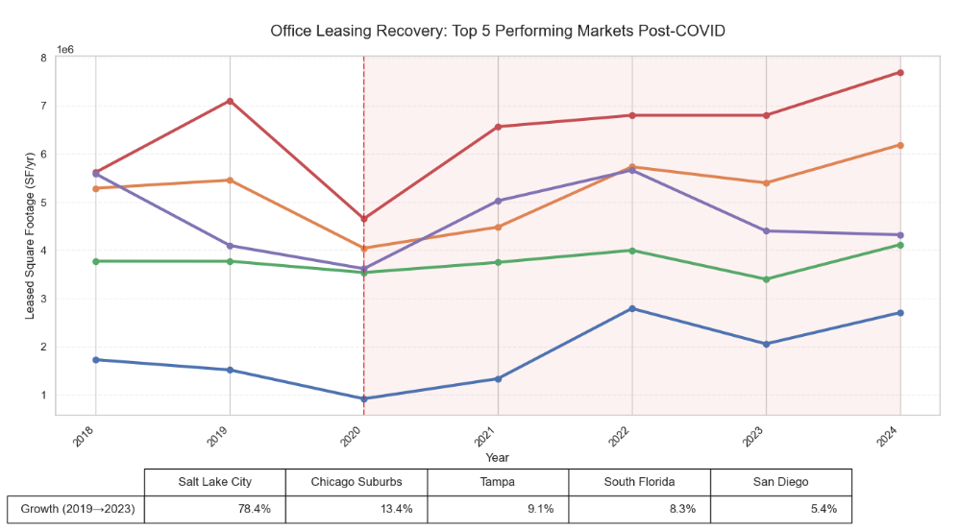
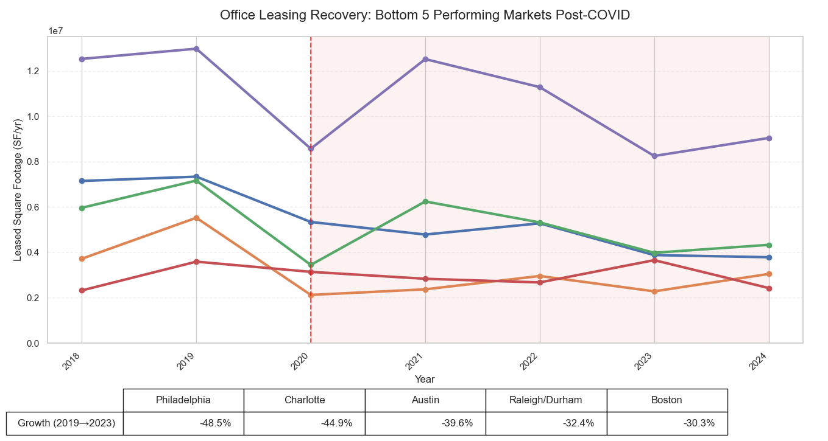
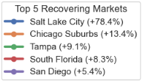
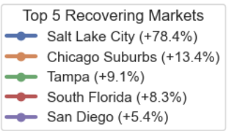
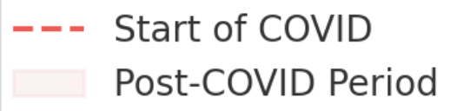
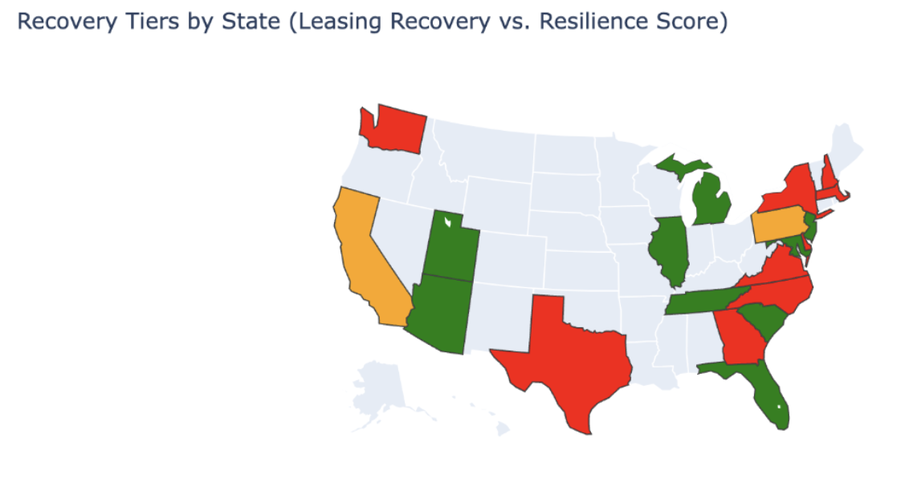
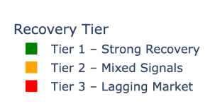
Who recovered the best?
Recovery = How strongly a market bounced back after its COVID low point → Higher recovery = faster rebound in leasing activity
By combining resiliency and recovery, we can pinpoint strategic investment targets.
Cities like New York and Chicago are seeing strong rebounds — → Signaling renewed demand and return-to-office momentum
Investment Strategy: Use recovery data to guide where to invest. Use resiliency data to guide how to structure deals (e.g., short-term flexible leases in high-recovery markets)

Slide 4
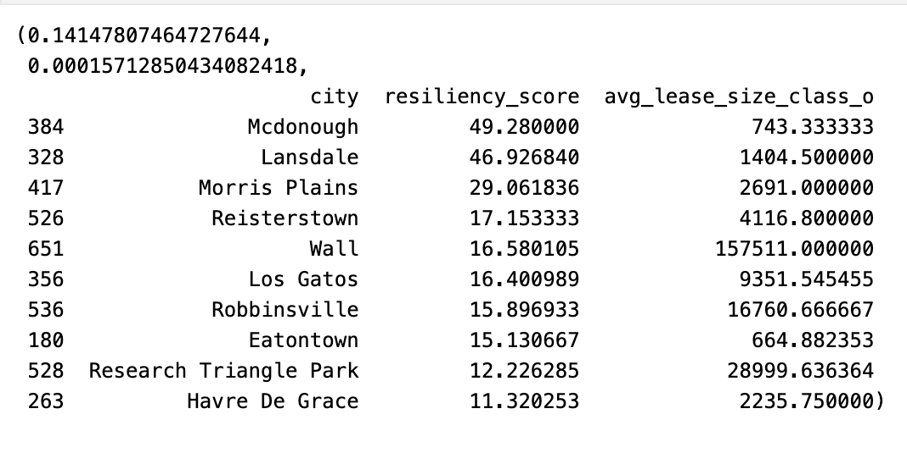
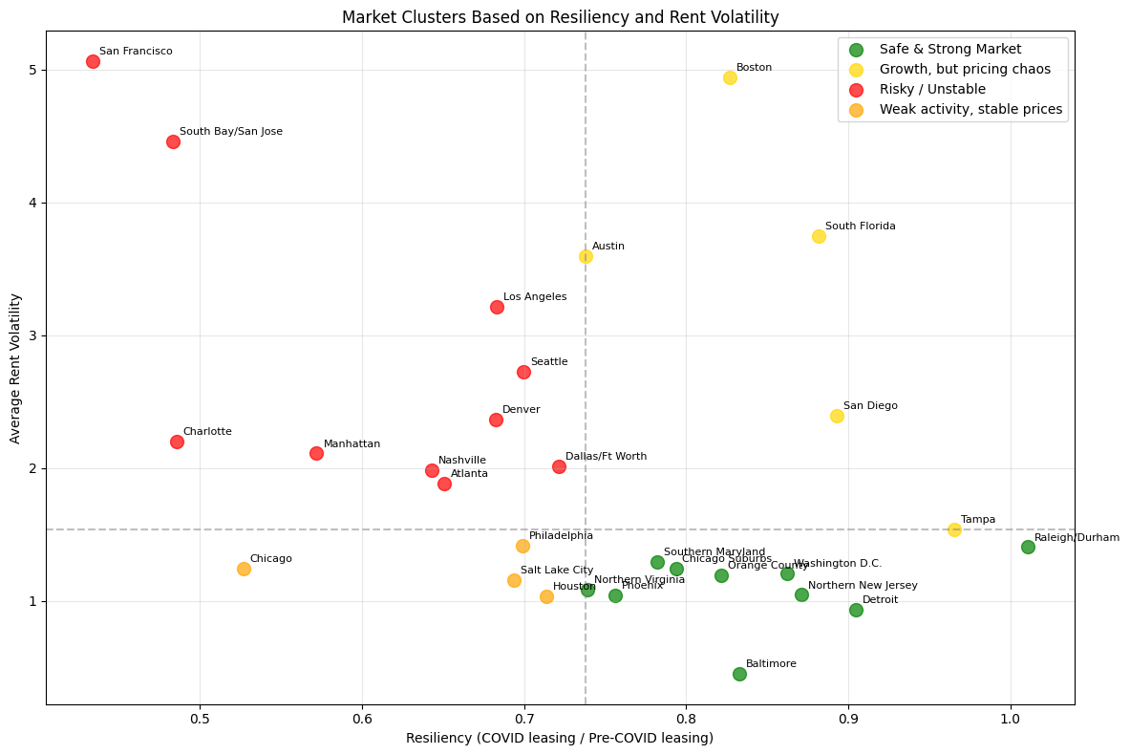
WHY are these cities resilient? Any trends?
Hypothesis: Is there a relationship between the cities that prefer class O offices with bigger average lease per Sq FT per deal compared to how resilient the city was during covid overall?
Why might this be?
Class O buildings are typically less expensive to buy, maintain, and lease.
You get in cheaper and still ride the upside of market recovery.
Why does this matter?
In a future economic downturn, focus on cities with high availability of Class O offices
These cities showed higher resiliency and faster recovery during COVID
Even with a weak correlation, the data is statistically significant — enough to guide strategy
R value (Correlation)
Key Finding:
There’s a weak but statistically significant positive correlation between: → A city’s average Class O lease size
→ Its resiliency during COVID
What This Suggests:
Cities with larger Class O deals may have kept leasing activity steady
Likely driven by cost-efficiency and flexibility of older buildings
Large tenants stayed active in secondary stock, boosting resilience
P Value
Class A space will always lead premium demand — but in many U.S. cities, Class O is where the real action is.
It’s affordable, stable, and increasingly in-demand by value-driven tenants. For investors and brokers, these markets represent less competition, more consistency, and strong leasing momentum

Slide 5
Thank you!

